Slide 1
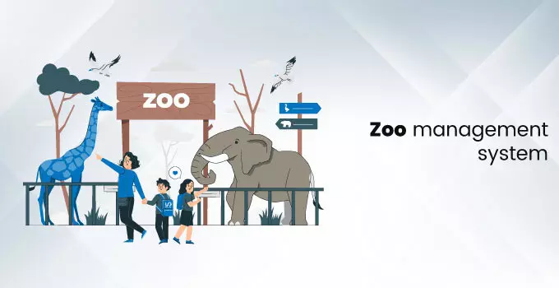

Slide 2
CLIENT INFORMATION
Client: Johannesburg Zoo is a zoo located in Johannesburg, Established in 1904.It is expanded over 140 acres of land.
The zoo is housing more than 2150 animals belonging to 320 species represents more than 30 countries.
Zoo is maintained by Johannesburg town council.

Slide 3
PROJECT BUSINESS NEEDS
It helps the zoo management in keeping track of the animals.
Saves the time and manages the data of the visitors.
It makes the ticketing process easier and also manages the data of the visitors.
Improves the customer services.
Improves the management of the animals.
The zoo management can keep the track of people who have visited the zoo in past.

Slide 4
Project Architecture
Zoo Management System
Animal
Details
Normal
Ticket
Reports
Foreigners
Ticket
Search
Manage Type
Ticket

Slide 5
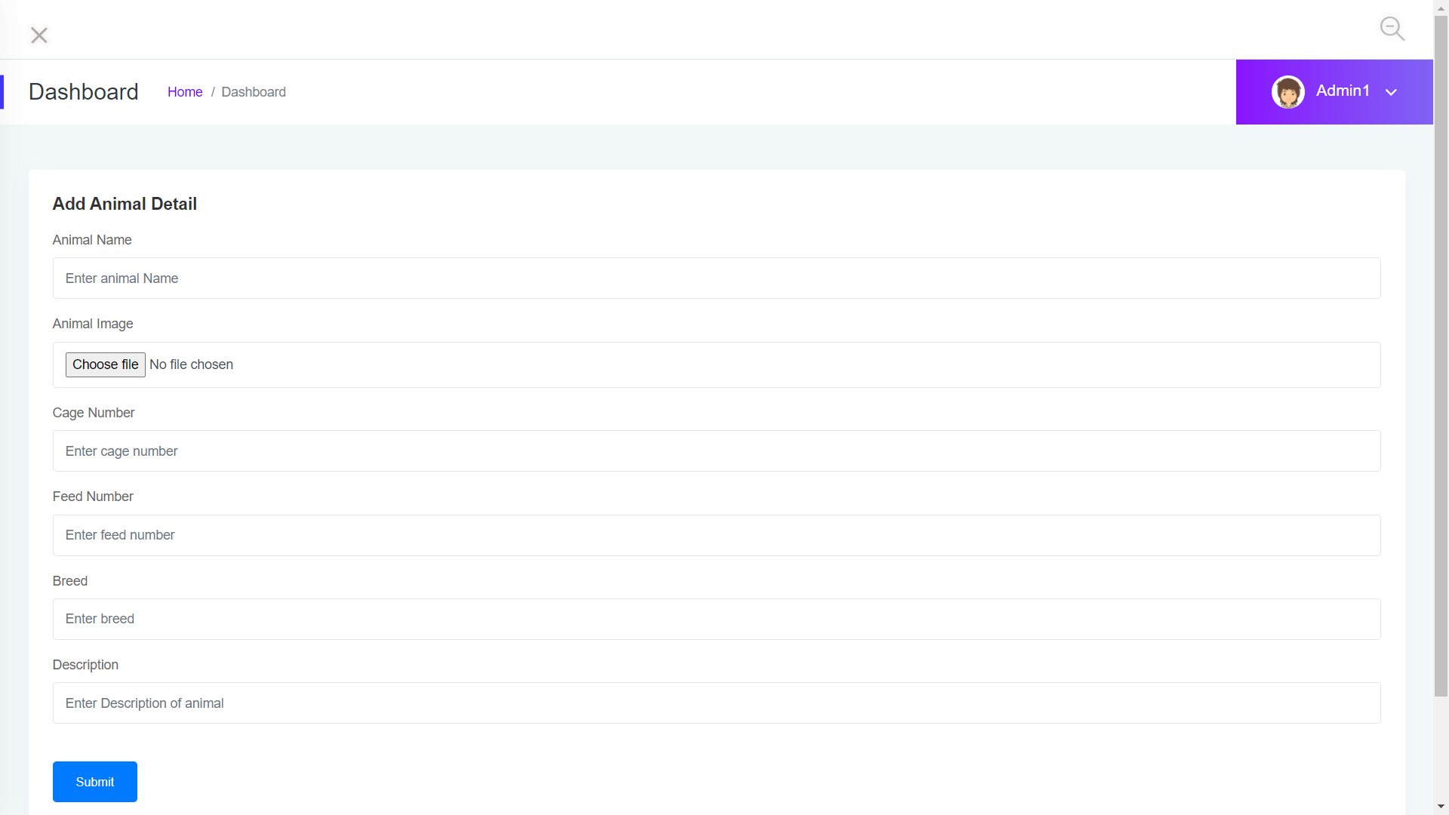
Animal Details
The Animal details module in Zoo management system helps the zoo management to add new animals in the list of animals and manage animals. It helps the management system to know that in which cage the animal has been kept and we get to know which type of breed they belongs to, and on which date they have been brought to the zoo.

Slide 6
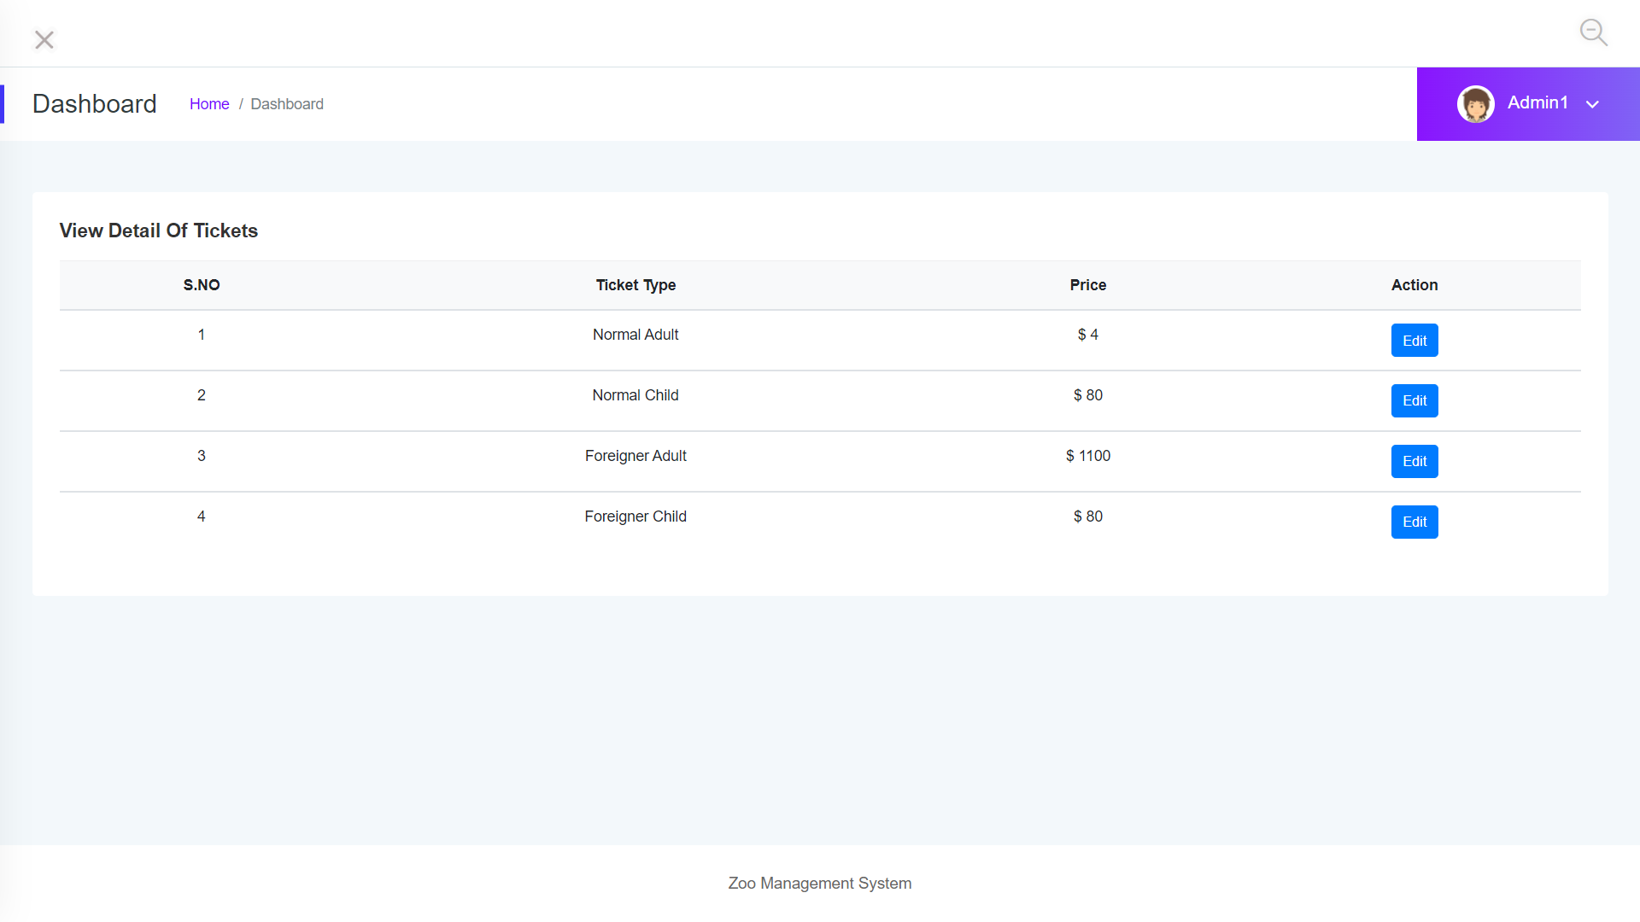
Manage Tickets
This module helps Zoo management System in fixing the prices of the tickets for Normal Adults, Normal Child, Foreigner Adult, Foreigner Child and we can change or update the prices for each type of tickets.

Slide 7
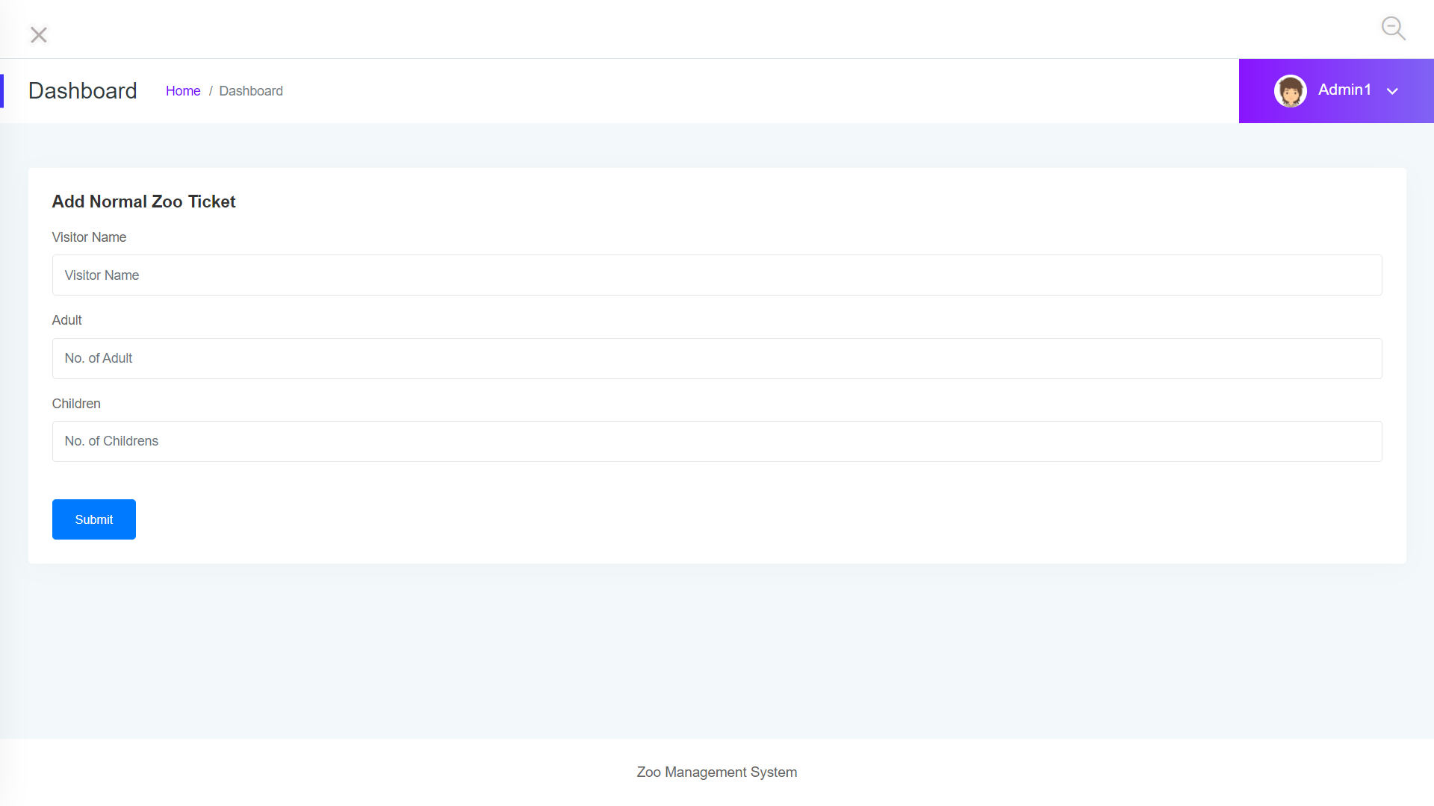
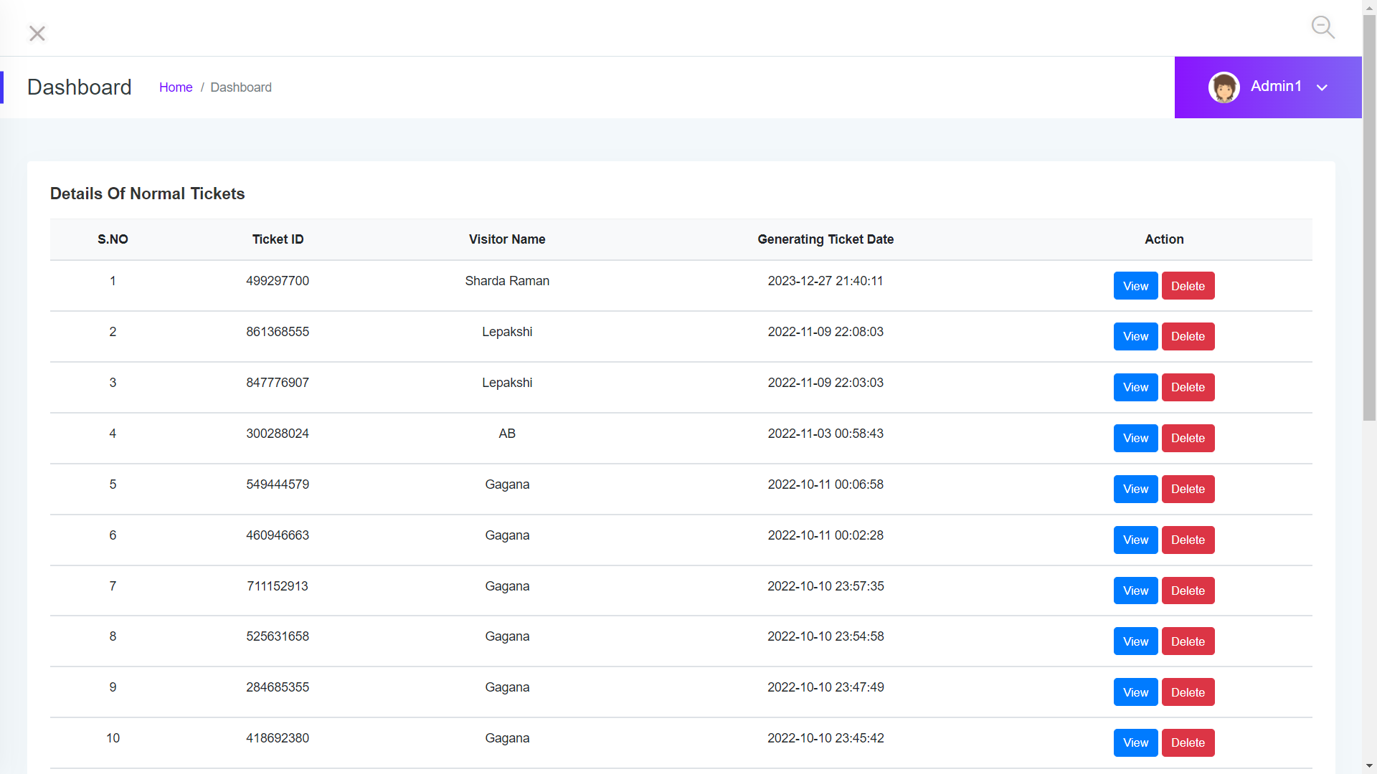
Normal Ticket
In Normal ticket module we can add persons of our own country. In this module the application will store all the data regarding the ticket buyer and it will generate a random ticket number for each and every ticket. Here we can see the details of the ticket.

Slide 8
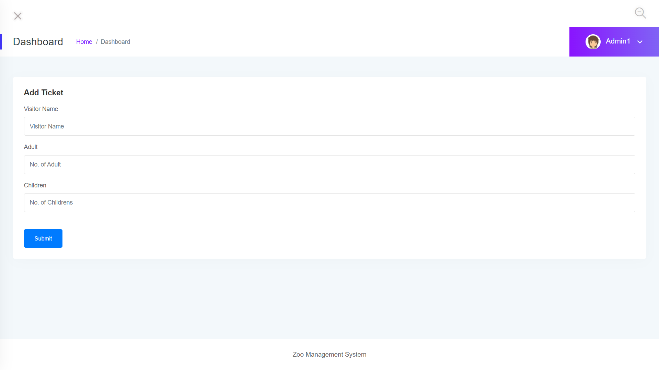
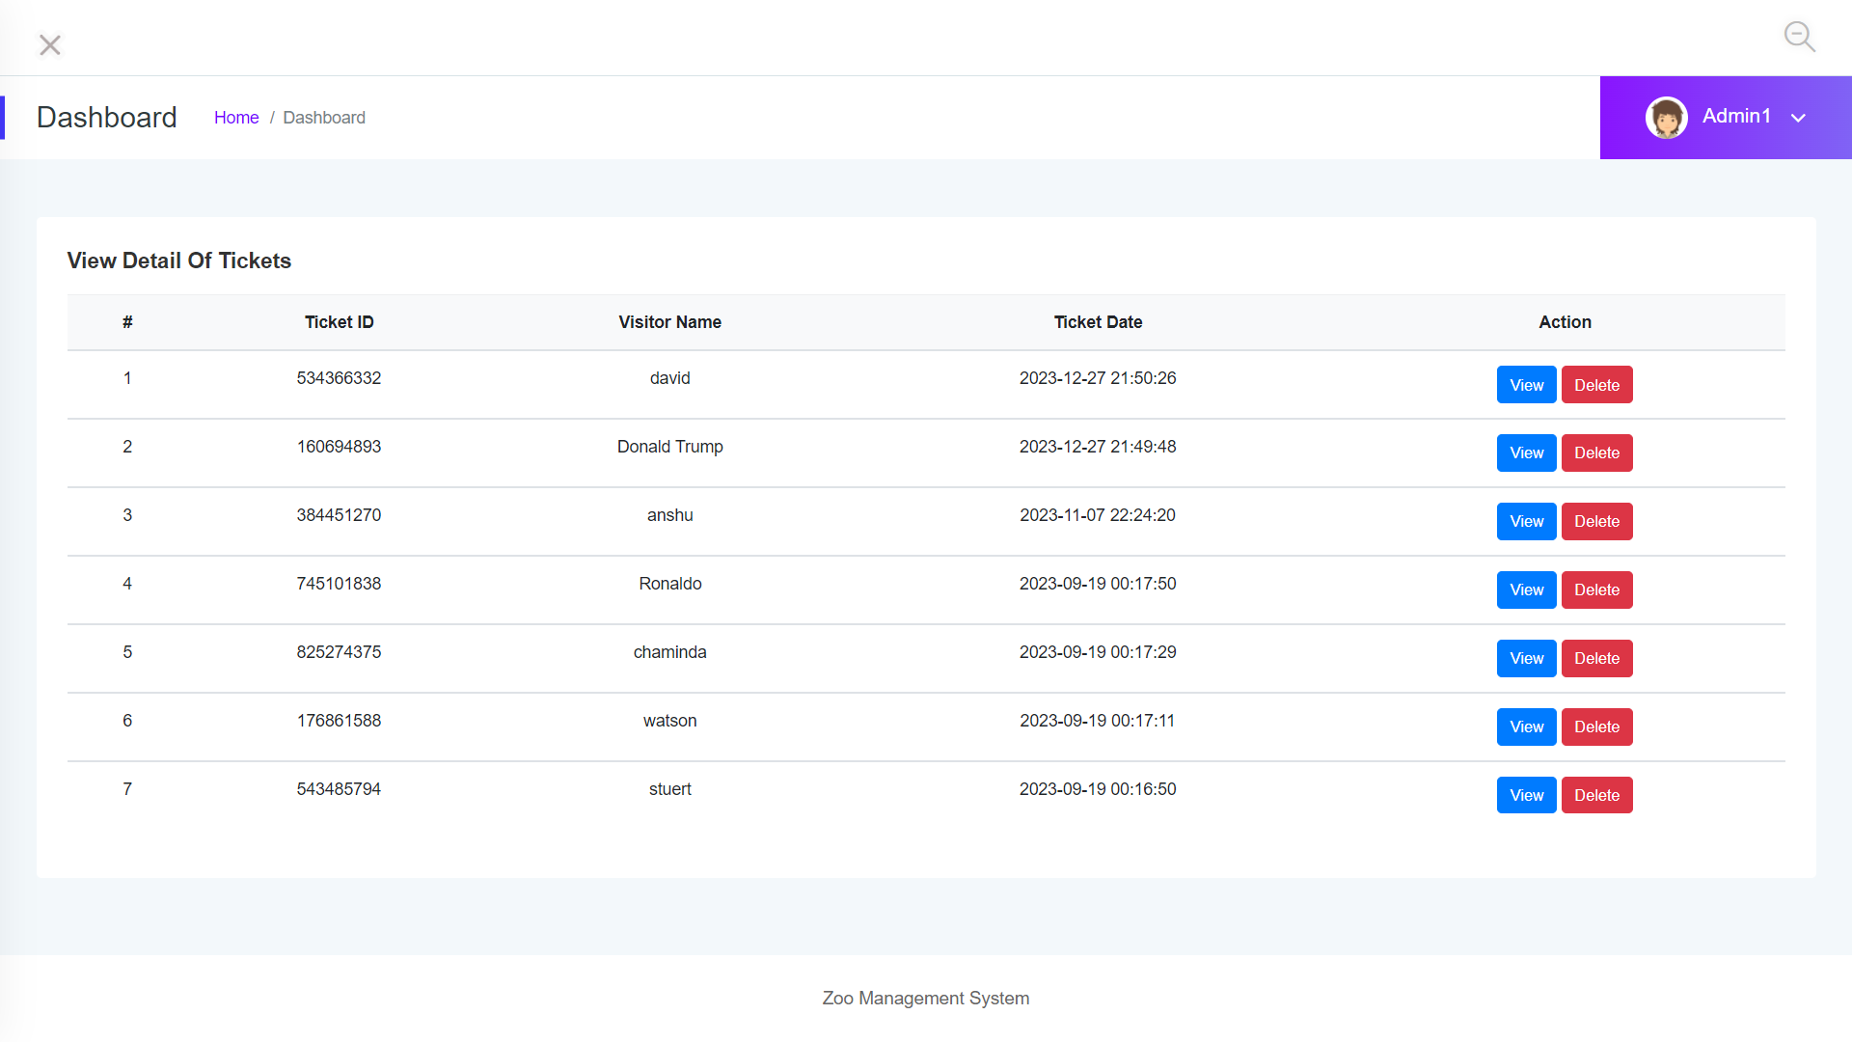
Foreigners Tickets
In Foreigners ticket module we can add persons of another countries . In this module the application will store all the data regarding the ticket buyer and it will generate a random ticket number for each and every ticket. Here we can see the details of the ticket.

Slide 9
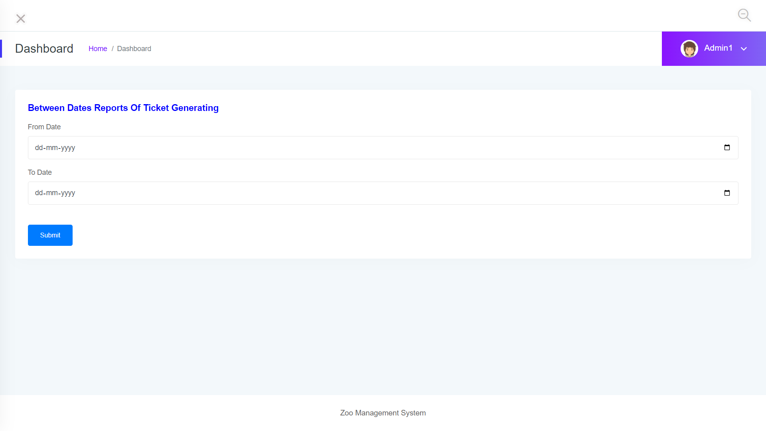
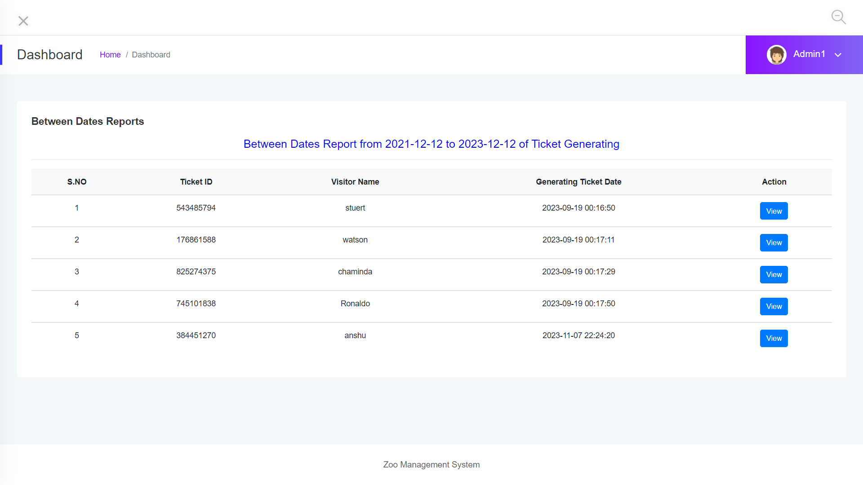
Reports Module
Reports Module generates the report which contains details of people who have visited the zoo in a particular range of dates. It asks for two dates 1. From Date and 2. To Date.

Slide 10
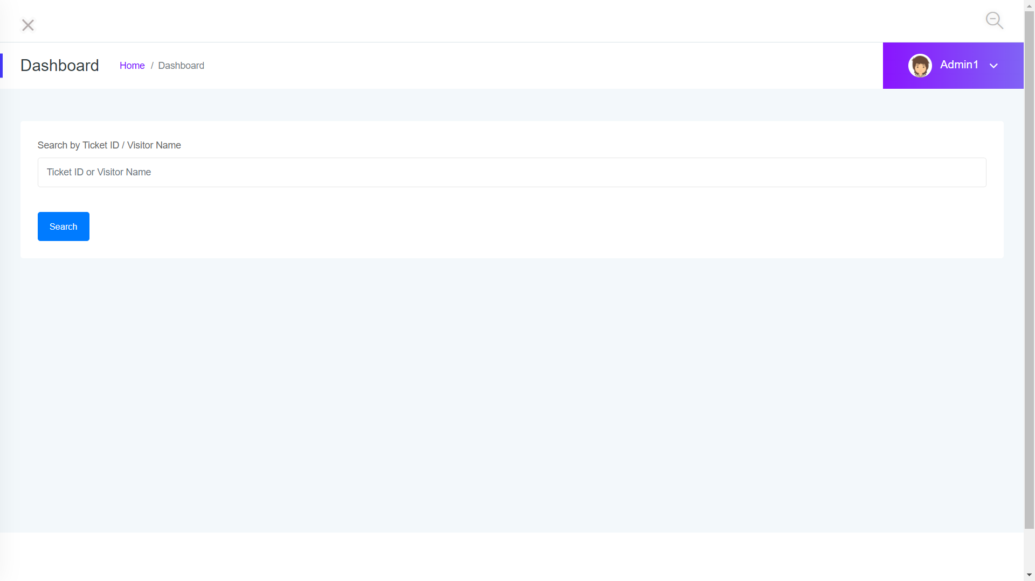
Search Module
This module generates the report of a individual based on there names and there id’s.

Slide 11
Functional Dependencies
Add Ticket
Add Animals
Normal
Ticket
Animal
Details
Dash Board
Manage Animals
Manage
Ticket
Search
Add Ticket
Foreigners
Tickets
Manage
Ticket

Slide 12
Business Scenarios:
Launch the Browser and Navigate through the URL,Login in to Zoo Management System Application with Valid Credentials ,Click on Animal Details,click on Add animals link , enter the necessary details and click on Submit Button. Hover on Manage Animals in Animal Details Module, then we will find that the animal which we have added will be displayed in Manage Animals page.

Slide 13
Business Scenario :
Launch the Browser and Navigate through the URL,Login in to Zoo Management System Application with valid Credentials, Click on Normal Ticket Drop Down , Click on Add ticket link, Add Normal Zoo Ticket Page Will be displayed, Enter all the required details and click on submit button, Hover On Normal Ticket Drop Down , Click on Manage ticket link, Details of Normal tickets page will be displayed and we can see the Details of person which we have added

Slide 14
End-End Scenario:
Launch the Browser and Navigate through the URL,Login in to Zoo Management System Application with valid Credentials, Click on Foreigners Ticket Drop Down ,Click on Add Ticket link , enter all the necessary details, View details of Tickets Page is displayed, Update Ticket Page is displayed, Edit the ticket cost, Click on Update button, A Pop Up message should be generated as Updated Successfully

Slide 15
End to end Scenario:
Launch the Browser and Navigate through the URL, Login in to Zoo Management System Application with valid Credentials,Click on Foreigners Ticket Drop Down, Click on Add ticket,Enter All the details and click on submit button, Hover on Manage ticket in Foreigners Ticket Drop Down ,Click on view button , Ticket details should be displayed, Copy the Ticket ID ,click on search Drop Down , click on Foreigners Ticket Search ,Paste the ID in the Search Ticket Id Text Field Click on Search Button

Slide 16
End-End Scenario:
Launch the Browser and Navigate through the URL, Login in to Zoo Management System Application with valid Credentials,Click on Normal Ticket Drop Down, Click on Add ticket,Enter All the details and click on submit button, Hover on Manage ticket in Normal Ticket Drop Down ,Click on view button , Ticket details should be displayed, Copy the Ticket ID ,click on search Drop Down click on Normal Ticket Search ,Paste the ID in the Search Ticket Id Text Field, Click on Search Button

Slide 17
DEFECTS PAGE:

Slide 18
Effort And Estimation
User Story Id | User Story Name | Tasks | Test Cases | Story Point | Men power Per Hour | Days
Us-01 | Animal Details | T-01 | + 30 | 02 | 16 | 02 Days
Us-02 | Manage Type Ticket | T-02 | +10 | 01 | 8 | 01 Day
Us-03 | Normal Ticket | T-03 | +10 | 01 | 8 | 1 Day
Us-04 | Foreigners Ticket | T-04 | +10 | 01 | 8 | 1 Day
Us-05 | Reports | T-05 | +10 | 01 | 8 | 1 day
Us-06 | Search | T-06 | +10 | 01 | 8 | 1 Day
Us-07

